Slide 1
The First World War 1914 - 1918
Mr. Condry’s Social Studies Class

Slide 2
The Entente Powers
Andorra
Armenia
Arab Rebels
Belgium
Brazil
China
Costa Rica
Cuba
Czechoslovak Legions
Emirate of Nejad and Hasa
France
Greece
Guatemala
Haiti
Honduras
Japan
Liberia
Nepal
New Hebrides
Nicaragua
Panama
Portugal
Romania
Russia
Serbia
Siam
United Kingdom
Canada
India
Newfoundland
Australia
New Zealand
Malta
South Africa
Rhodesia
United States
Alaska
Hawaii
Philippine Islands
Puerto Rico

Slide 3
Central Powers
Austria-Hungary
Azerbaijan Democratic Republic
Bulgaria
Banat Republic
Duchy of Courtland
Sernigallia
Dervish State
Democratic Republic of Georgia
Germany
Jabal Shammar
Kingdom of Lithuania
Ottoman Empire
South Africa Republic
Senussi
Kingdom of Poland
Sultanate of Darfur
Ukrainian State

Slide 4
Neutral Countries
Afghanistan
Principality of Albania
Argentina
Bolivia
Bhutan
Chile
Denmark
Ecuador
El Salvador
Ethiopia
Liechtenstein
Luxembourg
Bogd Khaanate of Mongolia
Mexico
Monaco
The Netherlands
Norway
Paraguay
Peru
Iran
San Marino
Spain
Spitsbergen
Sweden
Switzerland
Uruguay
Venezuela

Slide 5
Causes of the War
Historians believe there are four long term causes of the First World War
Nationalism
Imperialism
Militarism
Alliance System

Slide 6
Nationalism
A devotion to the interests and culture of one’s nation

Slide 7
Nationalism
Led to rivalries and conflicts between nations.
Various ethic groups resented domination by others and wanted independence
Russia and Austria-Hungary disagreed over the treatment of Serbs in central Europe

Slide 8
Imperialism
Economic and political control over weaker nations

Slide 9
Imperialism
For many centuries, European nations built empires.
Colonies supplied raw materials and provided markets for manufactured goods.
As Germany industrialized, it competed with other nations and colonies making it more competitive.

Slide 10
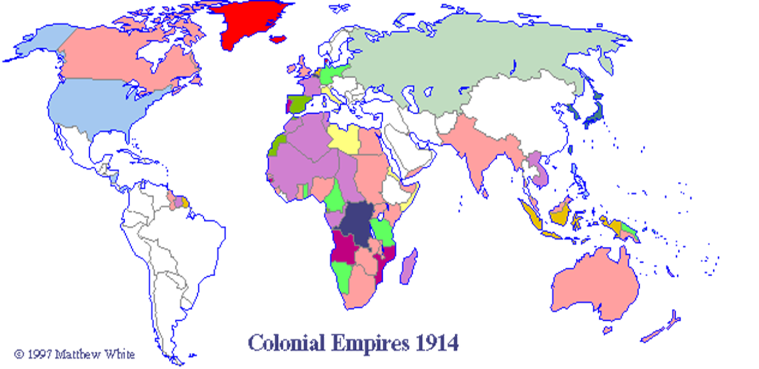

Slide 11
Militarism
The growth of nationalism and imperialism led to increased military spending

Slide 12
Militarism
Empires had to be defended and European nations increased military spending enormously in the late 19th and early 20th Century.
By 1890 the strongest nation militarily in Europe was Germany.
Germany had a strong army and built up a nave to rival England’s.
France, Italy, Japan, and the United States quickly joined in the naval buildup.

Slide 13
Battleships were being stockpiled by European nations, Japan, and America in the late 19th and early 20th Century.

Slide 14
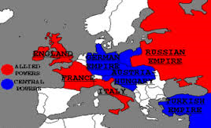
Alliance System
By 1907 Europe was divided into two armed camps

Slide 15
Alliance System
By 1907 there were two major defense alliances in Europe.
The Triple Entente, later known as the Allies, consisted of France, Britain, and Russia.
The Triple Alliance, later known as the Central Powers, consisted of Germany, Austria-Hungary, the Ottoman Empire and Italy

Slide 17
The Spark: The Beginning of World War 1
The Balkan region was considered “the powder keg of Europe” due to competing interests in the area.
Russia wanted access to the Mediterranean Sea.
Germany wanted railroad access to the Ottoman Empire.
Austria-Hungary, which had taken control of Bosnia in 1878, accused Serbia of Subverting its rule over Bosnia.

Slide 18
The Spark: The Beginning of World War 1
June of 1914, Archduke Franz Ferdinand, heir to the Austrian throne was gunned down
Killed by a Serbian radical named Gavrilo Princip a member of the Black Hand

Slide 19
The Fighting Begins
The Alliance System pulled one nation after another into the conflict
The Great War had begun on August 3, 1914.
Germany invaded Belgium, following a strategy known as the Schlieffen Plan.

Slide 20
Russia is off to War
August 1, 1914 Germany declares war on Russia
August 6, 1914 Austria-Hungry declare war on Russia
In Munich, crowds greet
the news that war has
been declared with
excitement. Adolf
Hitler, is there.

Slide 21
Schlieffen Plan
Quick strike attacks
Attack Belgium to Paris, France
Germany would attack Russia
The plan was designed to prevent a two-front war for Germany.

Slide 22
The War Becomes a Stalemate
Unable to save Belgium, the Allies retreated to the Marne River where they stopped the German advance in September of 1914.
Both sides dug in for a long siege.
By the spring of 1915, two parallel systems of deep trenches crossed France from Belgium to Switzerland.
Between enemy trenches was “no man’s land”

Slide 26
Battles in the Trench

Slide 27
Battles in the Trench

Slide 28
Dangers in the Trench: Rats

Slide 29
Dangers in the Trench: Trench Foot

Slide 30
Dangers in the Trench: Lice

Slide 31
Dangers in the Trench: Mustard Gas

Slide 32
Dangers in the Trench: Mustard Gas

Slide 33
First Battle of the Somme
Began on July 1, 1916 and lasted until mid-November
British suffered 60,000 casualties on the first day.
Trench warfare lasted for 3 years.
In 3 year period 1.2 million men killed and only 7 miles of ground was gained.

Slide 34
First Battle of the Somme
Allies Powers
Central Powers
Strength
51 British and 48 French Divisions
Casualties
420,000 British
200,000 French
Strength
50 Divisions
Casualties
434,000 – 500,000 German

Slide 35
The Lusitania Disaster
A British passenger liner that carried 1,198 persons.
Set sailed on May 7, 1915
A German U-boat sank the British liner killing all aboard including 128 American tourists.
The Germans claimed the ship was carrying Allied ammunition
Americans were outraged and public opinion turned against Germany and the Central Powers.

Slide 37
America Edges Closer to War
Several factors brought America into the war:
Germany ignored Wilson’s plea for peace.
The Zimmerman Note
Sinking of the Lusitania

Slide 38
Zimmerman Telegraph
A telegram from the German foreign minister to the German Ambassador in Mexico.
Proposed an alliance with Mexico and a return of their “lost territory” in Texas, New Mexico, and Arizona.

Slide 39
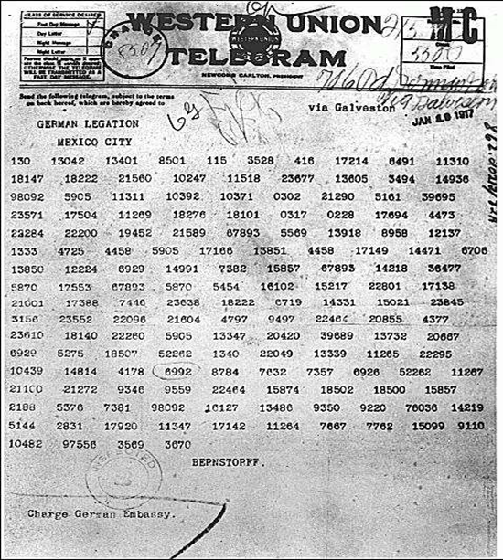
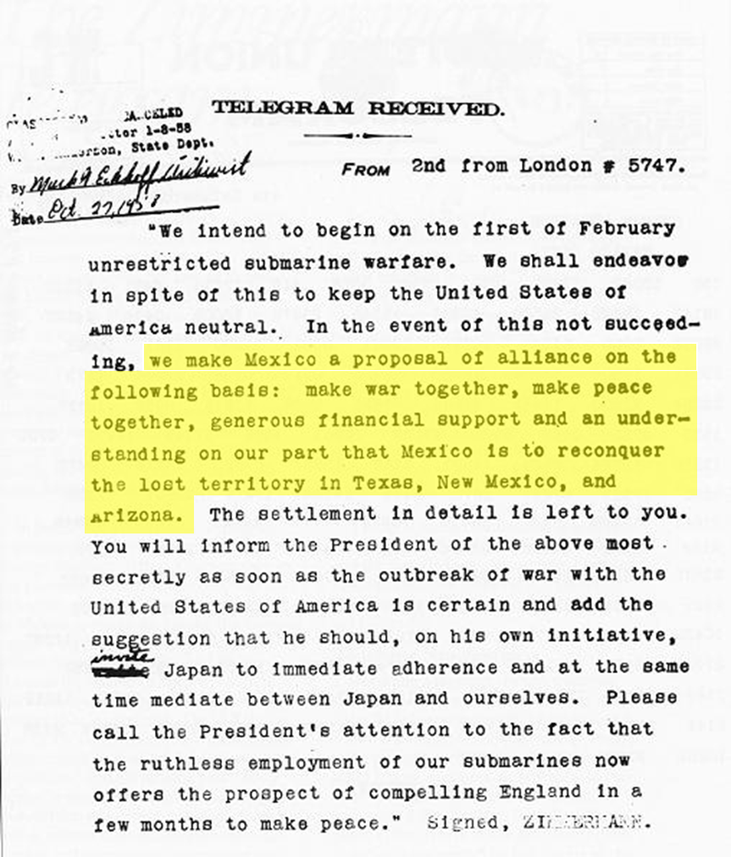

Slide 40
America Declares War
April 2, 1917
Wilson said, “The world must be made safe for democracy.”
Congress declares war a few days later.

Slide 41
Propaganda Posters
Posters used to get people to sign up for the war
Would use fear and nationalism to inspire recruitment
Lord Kitchener’s recruitment poster was famous.

Slide 43
The Germans had recruitment posters as well. Note the historical and religious themes.

Slide 45
Important New Weapons: Machine Guns
Guns could now fire 600 rounds per minute.
Vickers K Machine Gun
M1917 Browning Machine Gun

Slide 46
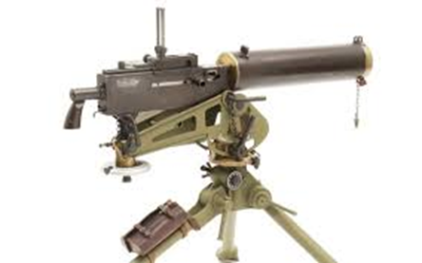
World War 1: Machine Guns
Maschinengwewhr 08 Lewis Gun
Maxim 1910 Schowarzlose MG M. 07/12

Slide 47
World War 1: Machine Guns
Hotchkiss M1914 Machine gun

Slide 48
Important New Weapons: The Tank
New steel tanks ran on caterpillar treads
Char d’Assault Schneider- French assault tank
Char d’Assault St. Chamond- French self-propelled gun tank

Slide 49
World War 1: Tanks
FIAT 2000 Prototype Heavy Tank: Italian tank
Ford Model 1918 3-ton Light Tank: American tank

Slide 50
World War 1: Tanks
Holt Gas-Electric Tank: United States prototype
K Grosskampfawagen (K-Wagen) Super-Heavy Tank: German tank

Slide 51
World War 1: Tanks
Leichter Kampfawagen 1 (LK 1) Prototype Light Tank: German tank
Leichter Kampfawagen 2 (LK 2) Light tank: German tank

Slide 52
World War 1: Tanks
Little Willie Landship Infantry Fighting Vehicle : British tank (1915)
M1917 6-ton Tank: American copy French Design (1918)

Slide 53
World War 1: Tanks
Medium Mark C (Hornet) Medium Tank: British Tank (1918)
Medium Tank Mk A (Whippet): British Tank (1918)

Slide 54
World War 1: Tanks
Renault FT-17 Light Tank: French (1917)
Sturmpanzerwagen A7V: German Tank (1917)

Slide 55
World War 1: Tanks
Sturmpanzerwagen Oberschlesien Assault Tank Prototype: German tank (1918)
Tank Mark IX Armored Personnel Carrier (APC)/Armored Fighting Vehicle (AFV): British (1918)

Slide 56
World War 1: Tanks
Mark VIII (International/Liberty) Armored Fighting Vehicle (AFV): United States and Britain (1919).
MK 1 (Big Willie/Centipede/Mother): British Medium/Heavy Tank 1916

Slide 57
World War 1: Tanks
MK II: Medium British tank (1917)
MK IV: Heavy Tank/Armored Fighting Vehicle (AFV) British (1917)

Slide 58
World War I: Tanks
MK V: Heavy Tank/Armored Fighting Vehicle (AFV) British (1918)
Tsar Tank (Lebedenko Tank/Netopyr): Mobile Weapons Platform (1915)

Slide 59
Important New Weapons: Airplanes
Early dogfights resembled duals, however by 1918 the British had a fleet of planes that could deliver bombs.
Countries different contributions
Canada- 2 planes (bomber, fighter)
France- 166 planes (bombers, fighters, reconnaissance, trainers)
Italian- 26 planes (bombers, fighters, reconnaissance)
Japan- 1 plane (reconnaissance)
Romania- 1 plane (trainer)
Russia- 18 planes (Patrol seaplane, trainer, reconnaissance, fighter, bomber)
England- 149 planes (bombers, patrol seaplane, trainer, reconnaissance, fighter, bomber, zeppelin fighter, patrol blimp, zeppelin airship)
United States- 47 planes (trainer, patrol blimp, reconnaissance, bomber, fighter.

Slide 60
World War 1: Planes
Fokker Eindecker – Single-seat German fighter plane
Siemens-Schuckert – Single-seat German fighter plane

Slide 61
World War 1: Airplanes
Sopwith Camel – Single Seat British fighter plane
Gotha G V – Long Range German Bomber

Slide 62
World War 1 - Airplanes
Handley Page 0/400 – Long range British bomber
Bristol Type 22 – British two-seater fighter plane.

Slide 63
Important New Weapons: Poison Gas
Mustard Gas was used to subdue the enemy

Slide 64
Other Weapons & Equipment: Howitzers

Slide 65
Other Weapons & Equipment: Flame Throwers

Slide 66
Other Weapons & Equipment: Torpedoes

Slide 67
Other Weapons & Equipment: U-boats

Slide 68
Other Weapons & Equipment: Phosphorus Grenades

Slide 69
Other Weapons & Equipment: Field Phones

Slide 70
Other Weapons & Equipment: Search Lights

Slide 71
Other Weapons & Equipment: Gas Masks

Slide 72
Other Weapons & Equipment: Camouflage

Slide 73
Other Weapons & Equipment: Railroad Guns

Slide 74
The Paris Gun
Could shoot a 210 lb. shell 80 miles!!!!

Slide 75
Before and After

Slide 76
Other Weapons & Equipment: Blimps

Slide 77
Royal Air Force (RAF)
The United Kingdom’s aerial warfare force.
Formed towards the end of the first world war on April 1, 1918.
The oldest independent air force in the world.

Slide 78
Battle of the Jutland
The only real major naval battle of the war.
Between Germany’s battleships and Britain’s battleships.

Slide 79
Battle of the Jutland
United Kingdom
Germany
Strengths
28 battleships
9 battlecruisers
8 armored cruisers
26 light cruisers
78 destroyers
1 minelayer
1 seaplane carrier
Casualties
6,094 killed
674 wounded
177 captured
3 battlecruisers
3 armored cruisers
8 destroyers.
Strength
16 battleships
5 battlecruisers
6 pre-dreadnoughts
11 light cruisers
61 torpedo-boats
Casualties
2,551 killed
507 Wounded
1 battle cruiser
1 pre-dreadnought
4 light cruisers
5 torpedo-boats

Slide 80
World War 1: Battleship
English German

Slide 81
World War 1: Battlecruiser
English German

Slide 82
World War 1: Armored Cruiser
English German

Slide 83
World War 1: Light Cruiser
English German

Slide 84
World War 1: Minelayer
English German

Slide 85
World War 1: Seaplane Carrier
English German

Slide 86
World War 1: Torpedo Boat
English German

Slide 87
World War 1: Pre-Dreadnaught
English German

Slide 88
American Troops Go On the Offensive
When Russia surrendered to the Germans in 1917, the Central Powers were able to focus on the Western Front.
By May, the Germans were within 50 miles of Paris. The Americans arrived and immediately played a major role in pushing the Germans back
In July and August the Americans helped the Allies win the Second Battle of the Marne.

Slide 89
Germany Collapses, War Ends
On November 3, 1918, Austria-Hungary, surrendered to the Allies.
That same day, German sailors mutinied against their government.
Other revolts followed, and Germany was too exhausted to continue.
So at the eleventh hour, on the eleventh day, of the eleventh month of 1918, Germany signed a truce ending the Great War.

Slide 90
Treaty of Versailles
The “Big Four” leaders worked out treaty details:
Wilson (U.S.)
Clemenceau (France)
Orlando (Italy)
Lloyd George (England)
Wilson conceded on most of his 14 points in return for the establishment of the League of Nations
On June 28, 1919 the Big Four and the leaders of the defeated nations gathered in the Hall of Mirrors at Versailles and signed the Treaty of Versailles.

Slide 91
Treaty of Versailles
The treaty established nine new nations including Poland, Czechoslovakia, and Yugoslavia
It broke up the Austro-Hungarian empire and the Ottoman Empire
It barred Germany from maintaining an army, required them to give Alsace-Lorraine back to France, and forced them to pay $33 billion in reparations to the Allies.

Slide 93
The Weakness of the Treaty
The harsh treatment of Germany prevented the treaty from creating a lasting peace in Europe
The treaty humiliated the Germans by forcing them to admit sole responsibility for the war (War-Guilt Clause)
Germany would never be able to pay $33 billion in reparations.

Slide 94
The Legacy of the War
At home, the war strengthened both the military and the power of the government.
The Propaganda campaign provoked powerful fears in society.
For many countries the war created political instability and violence that lasted for years.
Russia established the first Communist state during the war.
Americans called World War 1, “the war to end all wars”
Unresolved issues would eventually drag the U.S. into an even deadlier conflict.

Slide 95
WWI: The Numbers

